Slide 1
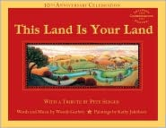
This Land is Your Land

Slide 2
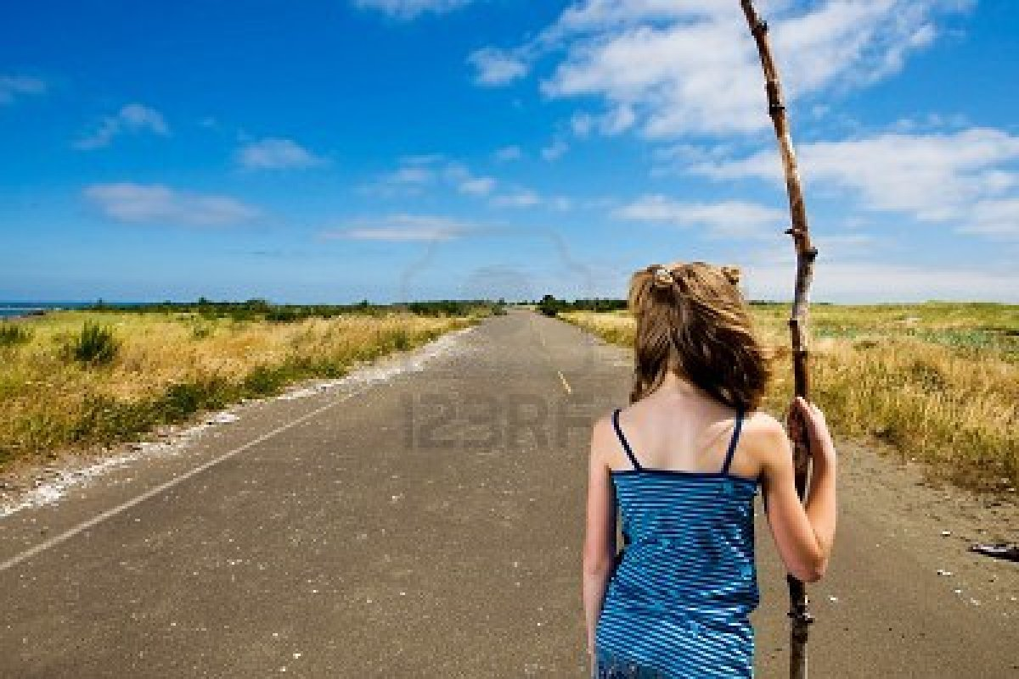
roamed
To walk around without having a place to go (wander)
The girl roamed the empty road.

Slide 3
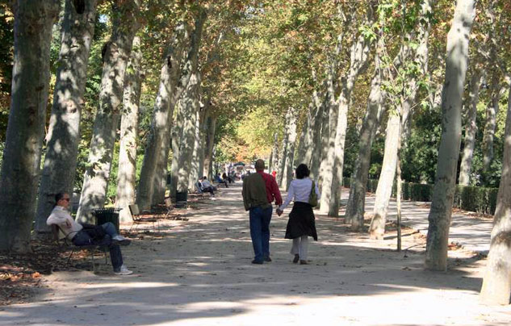
strolling
A relaxed slow walk
They went strolling through the park.

Slide 4
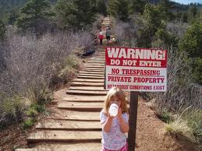
trespassing
To go into a place or space you are not allowed.
The little girl was trespassing on private property.

Slide 5
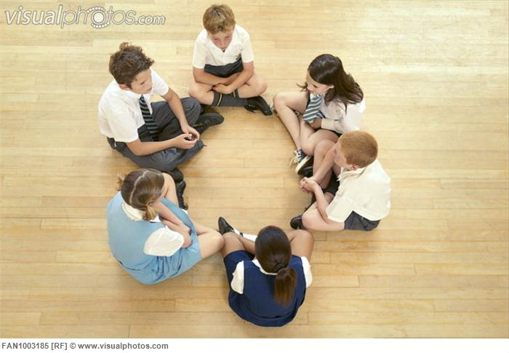
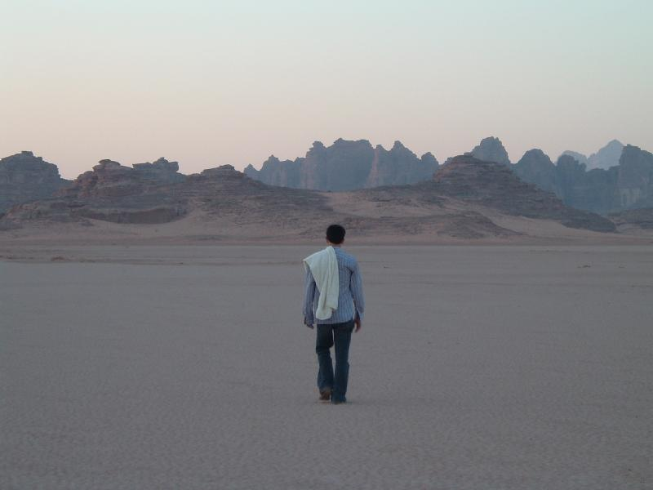
Which goes with roamed?

Slide 6
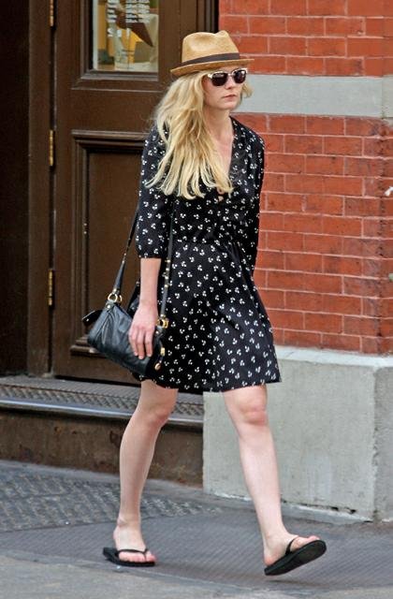
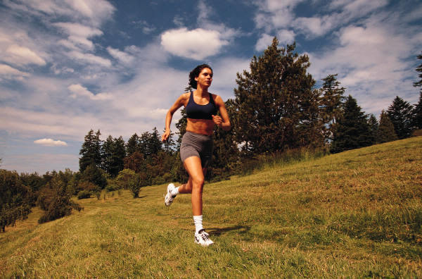
Which goes with strolling?

Slide 7
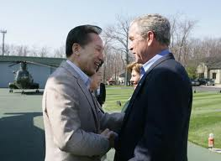
Which goes with trespassing?

Slide 8
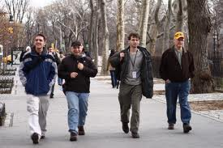
Which word goes with this picture? (roamed, strolling, trespassing)

Slide 9
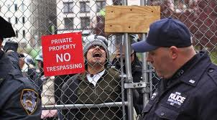
Which word goes with this picture? (roamed, strolling, trespassing)

Slide 10
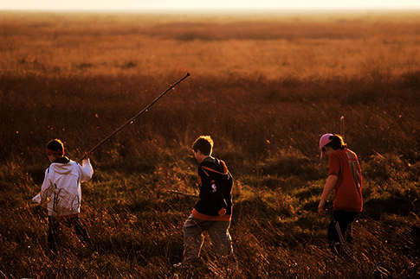
Which word goes with this picture? (roamed, strolling, trespassing)

